Slide 1
Lecture 25:
Reactions of alcohols:
Oxidation
Reactions of ethers
Reactions of thiols
Benzene

Slide 2
Characteristic Reactions of Alcohols:
Reduction with active metals: 2 ROH + 2 Na 2 RONa + H₂
Conversion to alkyl halides: ROH + HX RX + H₂O
3. Dehydration to alkenes: ROH H₂O + alkene (acid catalyst)
4. Oxidation to aldehydes, ketones or carboxylic acids:
ROH R’-CHO or R’R”CO or R’COOH

Slide 3
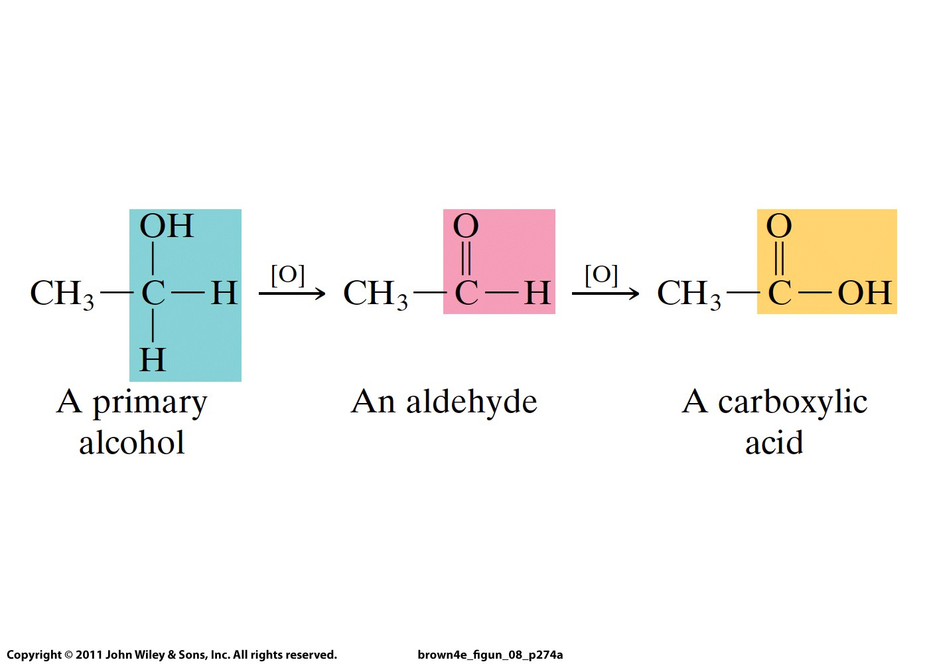

Slide 4
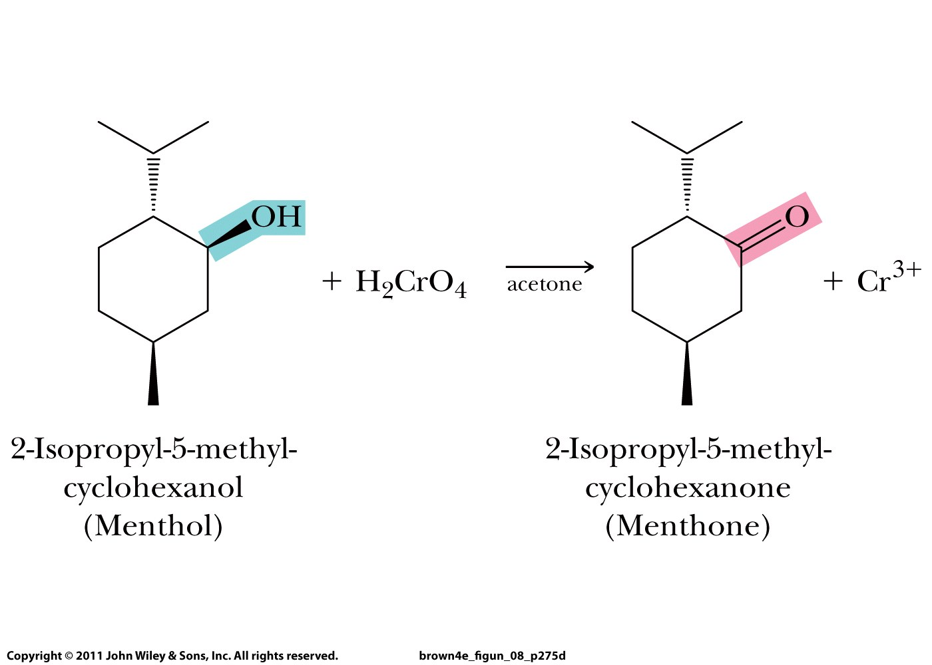

Slide 5
Ethers resemble hydrocarbons in their resistance to chemical reaction.
They do not react with strong oxidizing agents such as chromic acid, H₂CrO₄.
They are not affected by most acids and bases at moderate temperatures.
Because of their good solvent properties and general inertness to chemical reaction, ethers are excellent solvents in which to carry out organic reactions.

Slide 6
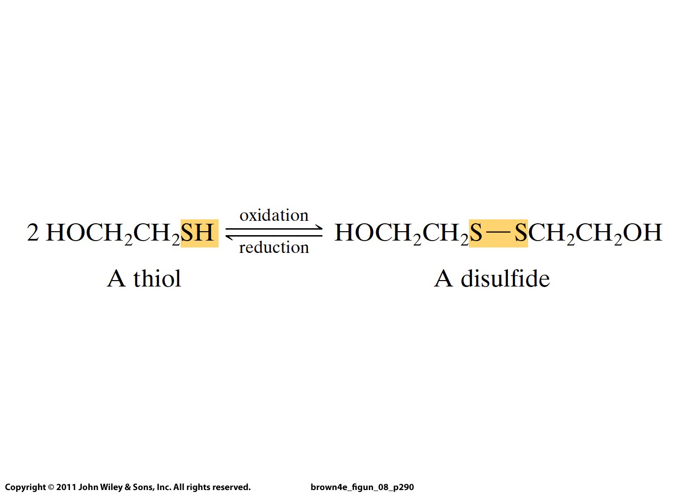
+ 2 H⁺ + 2 e⁻

Slide 7
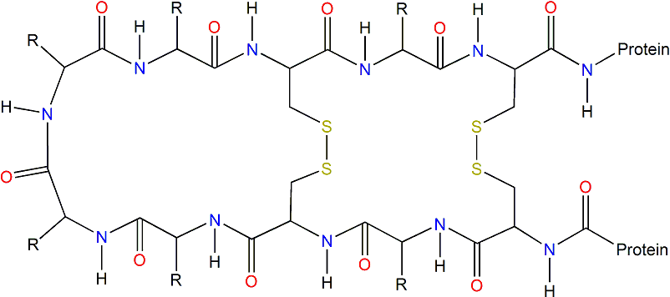
Disulfide bonds keep proteins in
specific three-dimensional shapes
necessary for their functioning

Slide 8
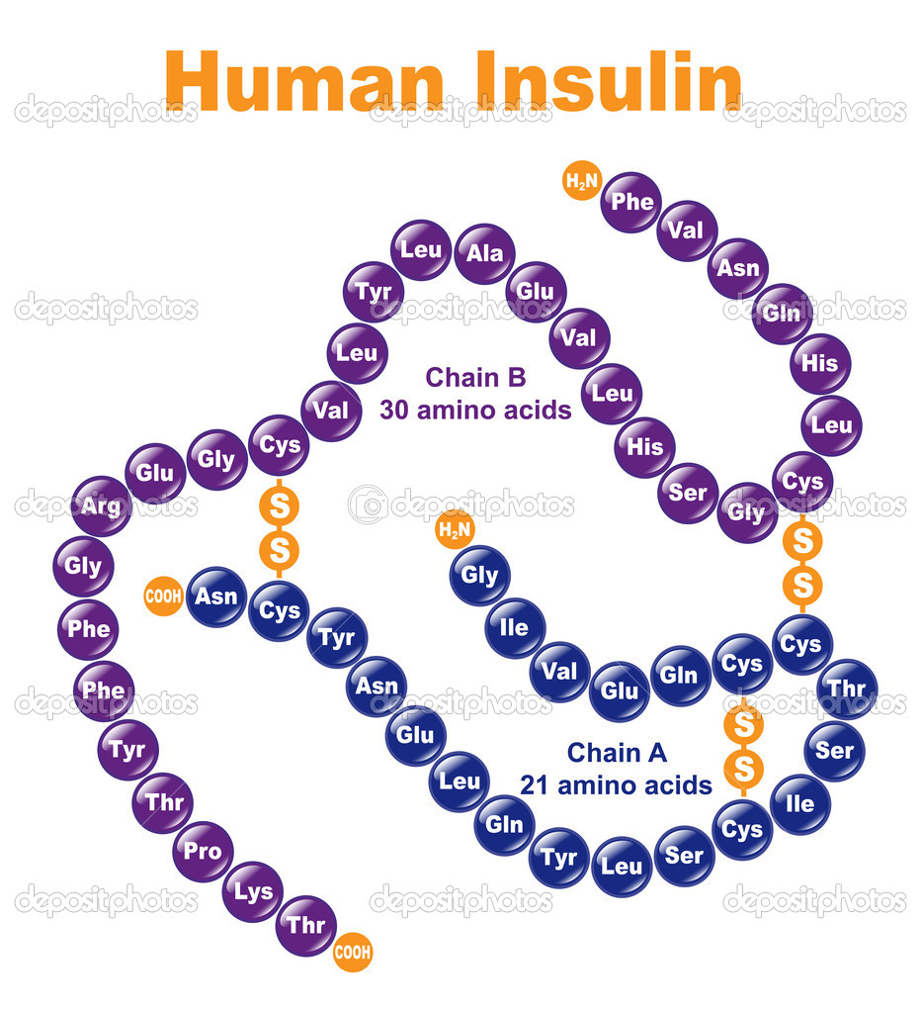
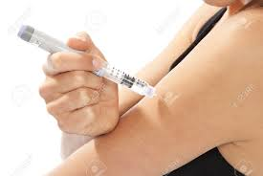

Slide 9
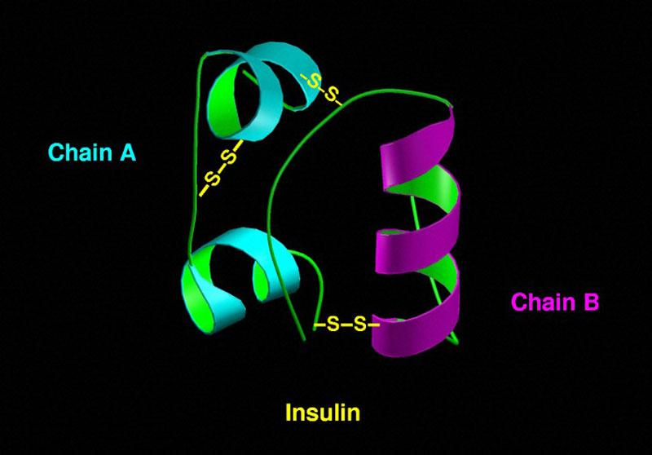

Slide 10
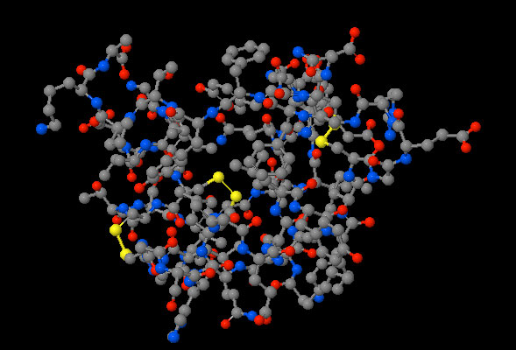

Slide 11
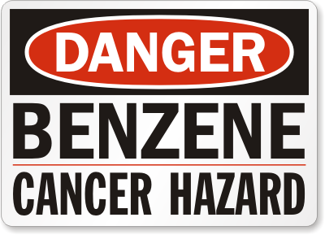

Slide 12
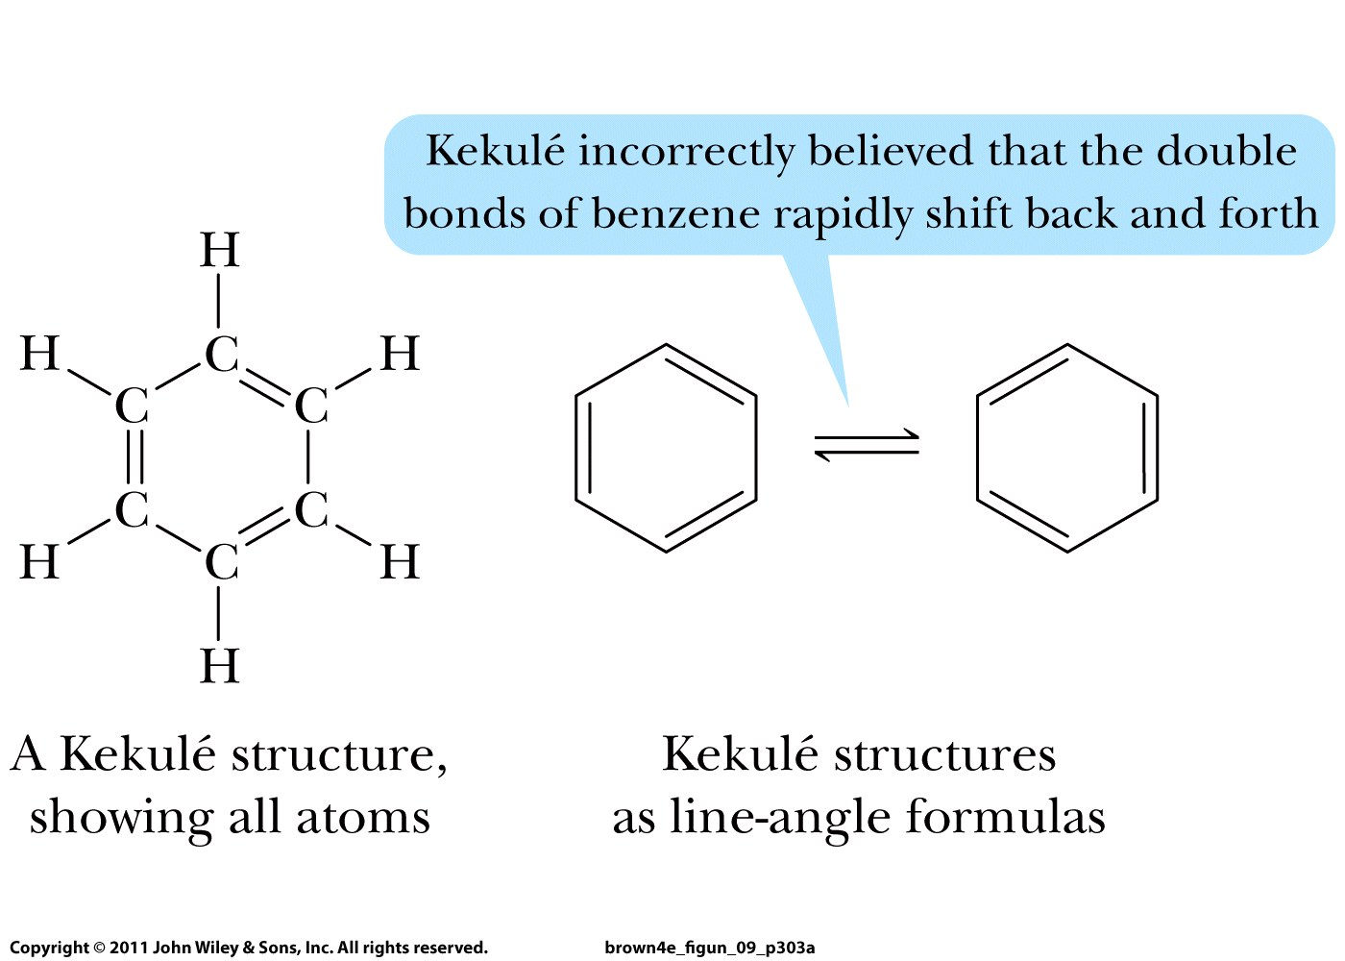
August Kekulé: first structure for benzene in 1872

Slide 13
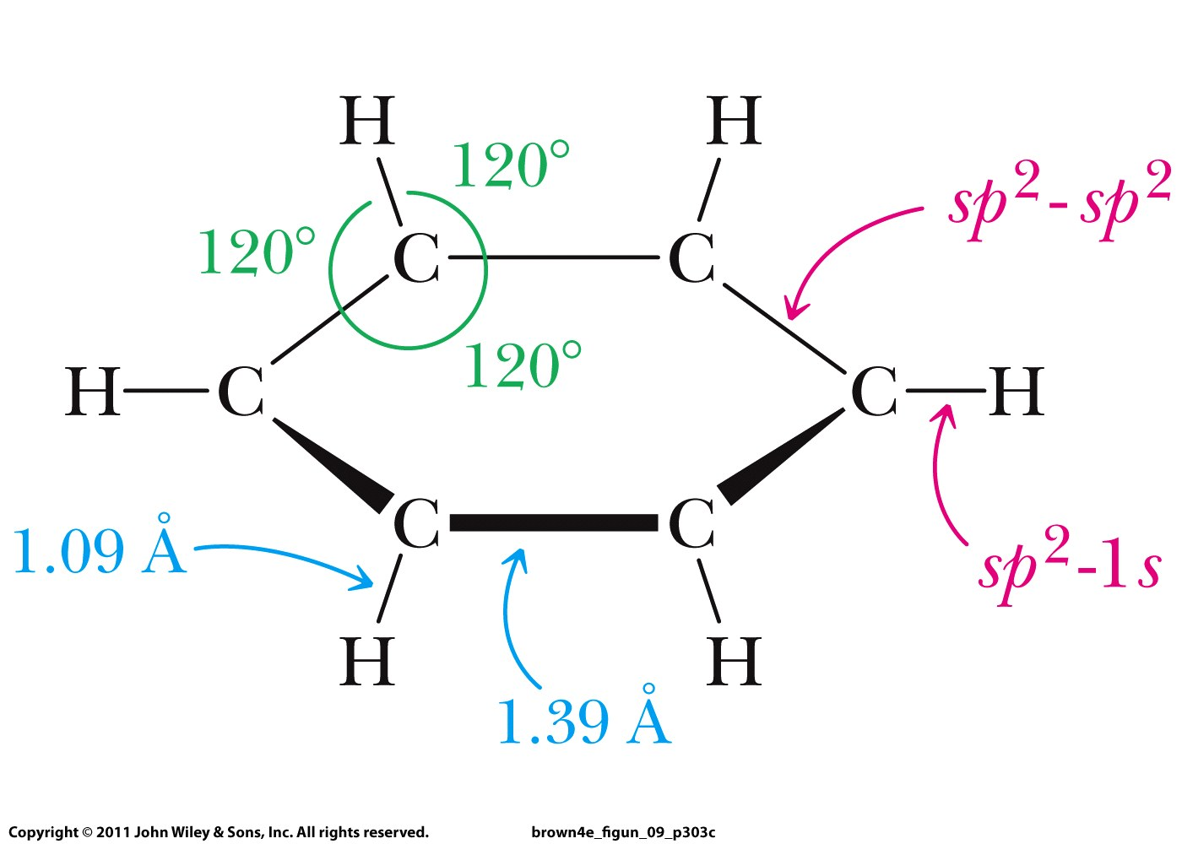
In reality, all C-C and C-H bonds are equally long:

Slide 14
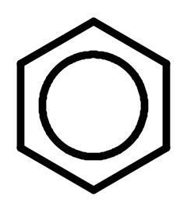
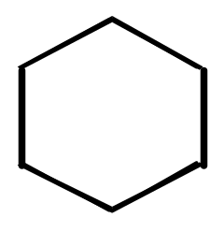

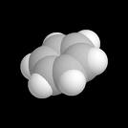
Benzene’s carbon skeleton is planar

Slide 15
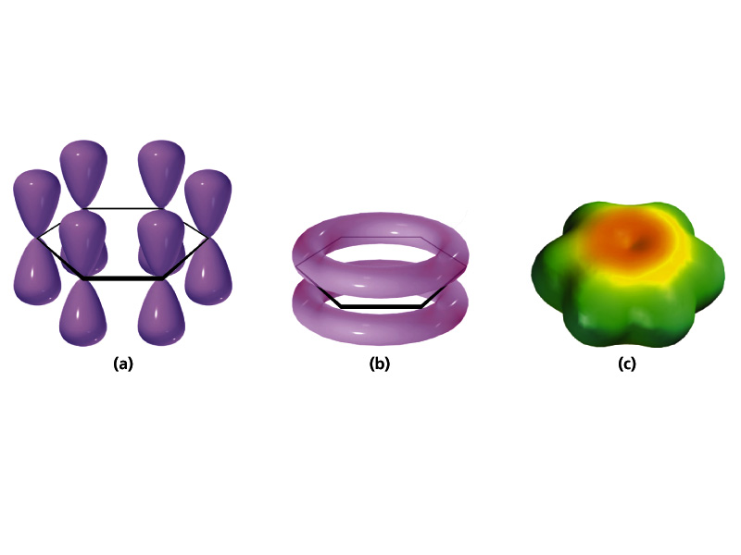
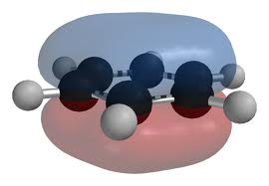
Different ways to show π-electrons in benzene

Slide 16
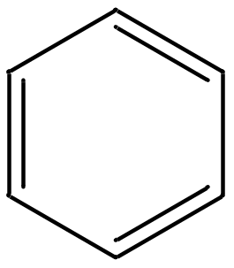

Aromatic molecules:
Cyclic
High degree of unsaturation
Planar or nearly planar
All atoms share (2 + 4 n) π-electrons in a cyclic
arrangement (n = any positive integer value)
Benzene

